Slide 1
Identification of URL based attacks from IP data
CSE7302- University Project
Review-3
Batch Number : CSE_98
Roll Number | Student Name
Under the Supervision of,
Dr. Jayachandran A
Professor
School of Computer Science and Engineering
Presidency University
20221CSE0199 | Karnatakam Manohith
20221CSE0245 | Vaddireddy Sivananda Reddy
20221CSE0221 | Palem Sreedhar Rao
Name of the Program: CSE
Name of the HoD: Dr .Blessed Prince
Name of the Program Project Coordinator: Mr. Muthuraju V
Name of the School Project Coordinators: Dr. Sampath A K , Dr. Geetha A

Slide 2
Abstract
Rapid growth of internet usage has increased URL-based cyber attacks. → Increased online activity has led to a rise in malicious URL attacks.
Traditional security systems fail to detect dynamic and obfuscated URLs. → Existing methods are ineffective against modern, hidden attack patterns.
This project uses deep learning to classify URLs as benign or malicious. → Deep learning models are applied to accurately classify URLs.
Real-time detection is provided through a web-based interface. → The system offers instant URL analysis using a web application.
Deep learning enables automatic feature learning from raw URL data. → The model learns complex patterns without manual rule definition.
The system enhances proactive cybersecurity defense mechanisms. → Early detection helps prevent potential cyber threats.

Slide 3
Literature Survey (IEEE Indexed)
Authors (Year) | Malware / Attack Category | Features Used | Learning Model Used / Developed | Performance Metrics | Accuracy (%)
Said Y. et al. (2024) | Phishing Websites | URL lexical features, webpage content features | CNN with Attention Mechanism | Accuracy, Precision, Recall, F1-score | 98.2%
Adebowale M.A. et al. (2023) | Phishing URLs | Lexical URL features, domain-based features | Deep Neural Network (DNN), LSTM | Accuracy, Precision, Recall | 97.6%
Atrees M. et al. (2022) | Malicious URLs | Lexical URL features (length, tokens, special characters) | Boosting-based ML models (XGBoost) | Accuracy, Detection Rate | 96.1%
Wang W. et al. (2020) | Malicious URLs | Hybrid features (lexical + host-based) | Random Forest, SVM | Accuracy, False Positive Rate | 95.4%
Yerima S.Y. et al. (2020) | Phishing URLs | Character-level URL features | Convolutional Neural Network (CNN) | Accuracy, ROC-AUC | 98.0%
Ma J. et al. (2019) | Malicious URLs | Lexical and host-based features | SVM, Naïve Bayes | Accuracy, False Positive Rate | 94.3%

Slide 4
Literature Survey (IEEE Indexed)
Authors (Year) | Malware / Attack Category | Features Used | Learning Model Used / Developed | Performance Metrics | Accuracy (%)
Le A. et al. (2021) | Malicious URLs | Raw URL strings (character-level) | End-to-End Deep Learning Model | Accuracy, Recall | 97.1%
Xiao X. et al. (2022) | Phishing URLs | URL tokens, lexical features | CNN with Self-Attention | Precision, Recall, F1-score | 98.5%
Rao R.S. et al. (2022) | Web Attacks (Phishing, Malware, Benign) | URL features, IP-based features | Deep Learning Model (ANN) | Accuracy, Precision, Recall | 96.8%
Sahoo D. et al. (2019) | Phishing Attacks | Survey of URL, content, and host-based features | Survey (No model implementation) | Not Applicable | 98.8%

Slide 5
Objectives
To identify malicious URLs using deep learning techniques. → The system aims to detect harmful URLs using neural networks.
To classify URLs into phishing, malware, spam, defacement, and benign. → URLs are categorized into multiple attack types for better analysis.
To improve detection accuracy and reduce false positives. → The model focuses on reliable detection with fewer incorrect alerts.
To enable early detection of URL-based attacks. → The system aims to identify threats before they cause damage.
To support automated URL security analysis. → Manual inspection is eliminated through automated deep learning models.
To enhance web and network security. → The project strengthens protection against malicious web activities.

Slide 6
Existing Methods and Drawbacks
Blacklist-based filtering and rule-based systems. → Traditional systems rely on predefined rules and known malicious URLs.
Traditional ML algorithms like SVM and Naïve Bayes. → Earlier solutions used basic machine learning classifiers.
Drawbacks: poor zero-day detection and high false positives. → These methods fail to detect new attacks and generate incorrect alerts.
Signature-based detection techniques. → These methods detect attacks only if their signatures are already known.
Heuristic-based URL analysis. → Uses manually crafted rules which are difficult to update for new threats.
Dependence on manual feature engineering. → Requires expert knowledge and does not scale well for large datasets.
Limited adaptability to evolving attack patterns. → Traditional systems cannot automatically learn new attack behaviors

Slide 7
Proposed Method & Feasibility Study
Feature extraction from URLs and IP-related data. → Important spatial and structural patterns are extracted from URL strings and IP features.
CNN-based deep learning classification model. → A Convolutional Neural Network (CNN) is used to automatically learn local patterns from URL character sequences and IP data.
Technically feasible using open-source frameworks. → Can be implemented using TensorFlow / Keras / PyTorch.
Low cost and minimal hardware requirement. → CNN for URL classification works efficiently on standard systems without high-end GPUs.
LSTM-based deep learning classification model. → A Long Short-Term Memory (LSTM) network is used to analyze sequential dependencies in URL characters and tokens.
Moderate hardware requirement. → LSTM requires slightly more computational time than CNN due to sequential processing but runs on standard systems.

Slide 8
System Architecture
User Interface
(Web Browser)
Flask Backend API
Feature Extraction
Module
Deep Learning
Model (ANN)

Slide 9
Flowchart – URL Attack Detection
Start
Enter URL
Extract URL & IP Features
Deep Learning Classification
Benign / Attack Type
Display Result
End

Slide 10
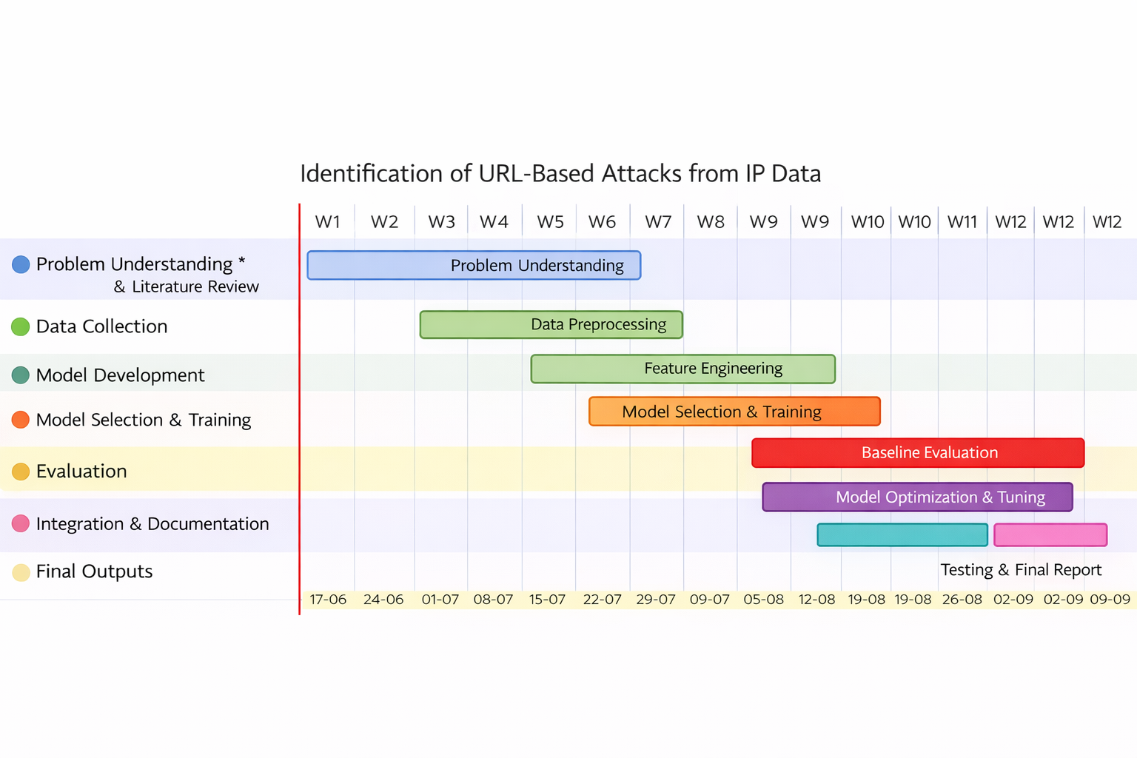
Project Timeline (Gantt Chart)

Slide 11
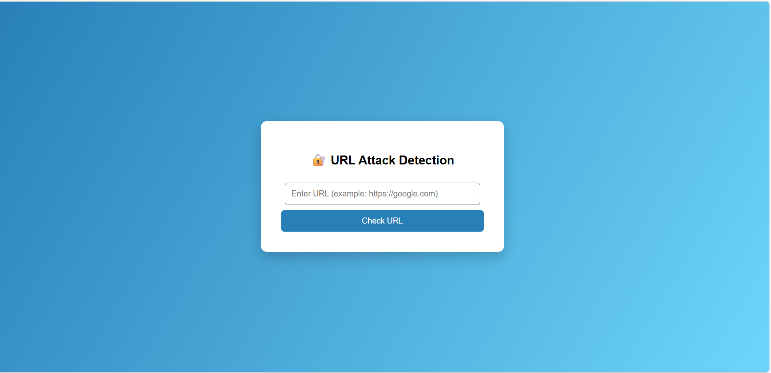
Working Output

Slide 12
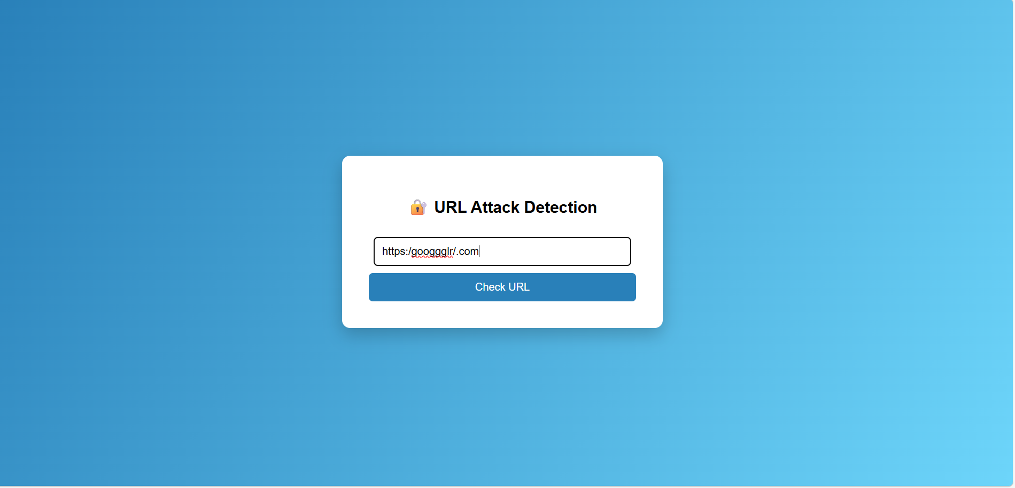
Continue

Slide 13
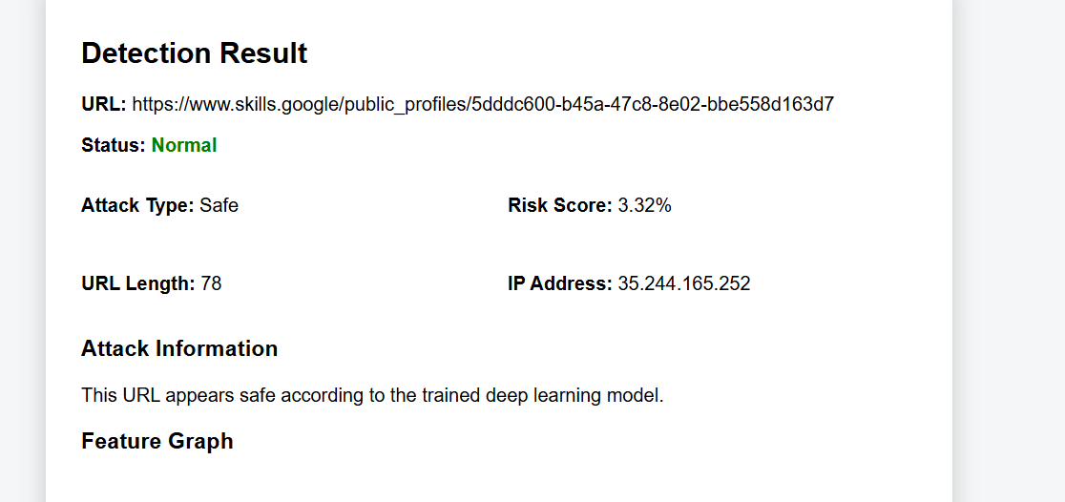
Continue

Slide 14
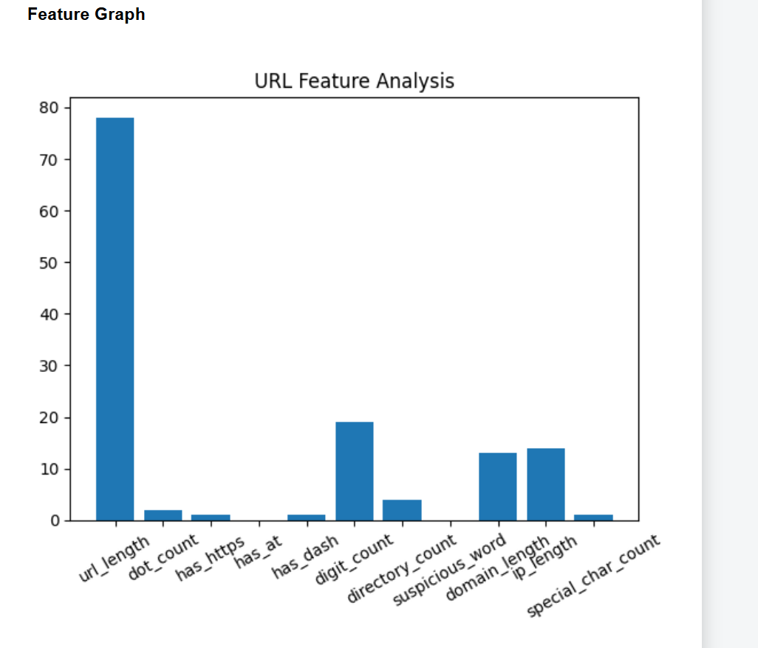
Continue

Slide 15
Conclusion
Deep learning improves accuracy in URL attack detection. → Neural networks provide better detection than traditional methods.
System effectively classifies multiple attack types. → The model successfully identifies different malicious categories.
Suitable for real-time cybersecurity applications. → The system can be deployed for real-time security monitoring.
ANN-based model outperforms traditional methods. → Achieves better accuracy and lower false positives.
Web-based interface improves usability. → Makes the system accessible to non-technical users.
Future scope includes hybrid deep learning models. → CNN, LSTM, or attention-based models can further improve detection.

Slide 16
References (IEEE Paper format)
Said, Y.; Alsheikhy, A.A.; Lahza, H.; Shawly, T. Detecting Phishing Websites through Improving Convolutional Neural Networks with Self-Attention Mechanism. Ain Shams Eng. J. 2024, 15, 102643.
Adebowale, M.A.; Lwin, K.T.; Hossain, M.A. Intelligent Phishing Detection Scheme Using Deep Learning Algorithms. J. Enterp. Inf. Manag. 2023, 36, 747–766.
Atrees, M.; Ahmad, A.; Alghanim, F. Enhancing Detection of Malicious Urls Using Boosting and Lexical Features. Intell. Autom. Soft Comput 2022, 31, 1405–1422.
Xiao, X.; Xiao, W.; Zhang, D.; Zhang, B.; Hu, G.; Li, Q.; Xia, S. Phishing Websites Detection via CNN and Multi-Head Self-Attention on Imbalanced Datasets. Comput. Secur. 2022, 108, 102372.
Yerima, S.Y.; Alzaylaee, M.K. High Accuracy Phishing Detection Based on Convolutional Neural Networks. In Proceedings of the ICCAIS 2020–3rd International Conference on Computer Applications and Information Security, Riyadh, Saudi Arabia, 19–21 March 2020.

Slide 17


